Slide 1






Week 03 – Demo
Tünde Csapó
Green Fox Academy / Fulvipes / Secret
tundecsapo
Tunde Csapo

Slide 2
< 4th Green Fox Week >
Monday: Training / Trial Exam
Tuesday: Inheritance
Wednesday: Abstracts and Interfaces
Thursday: OO + Testing
Friday: Todo App

Slide 3
< Reservations & Charcodes >

Slide 4
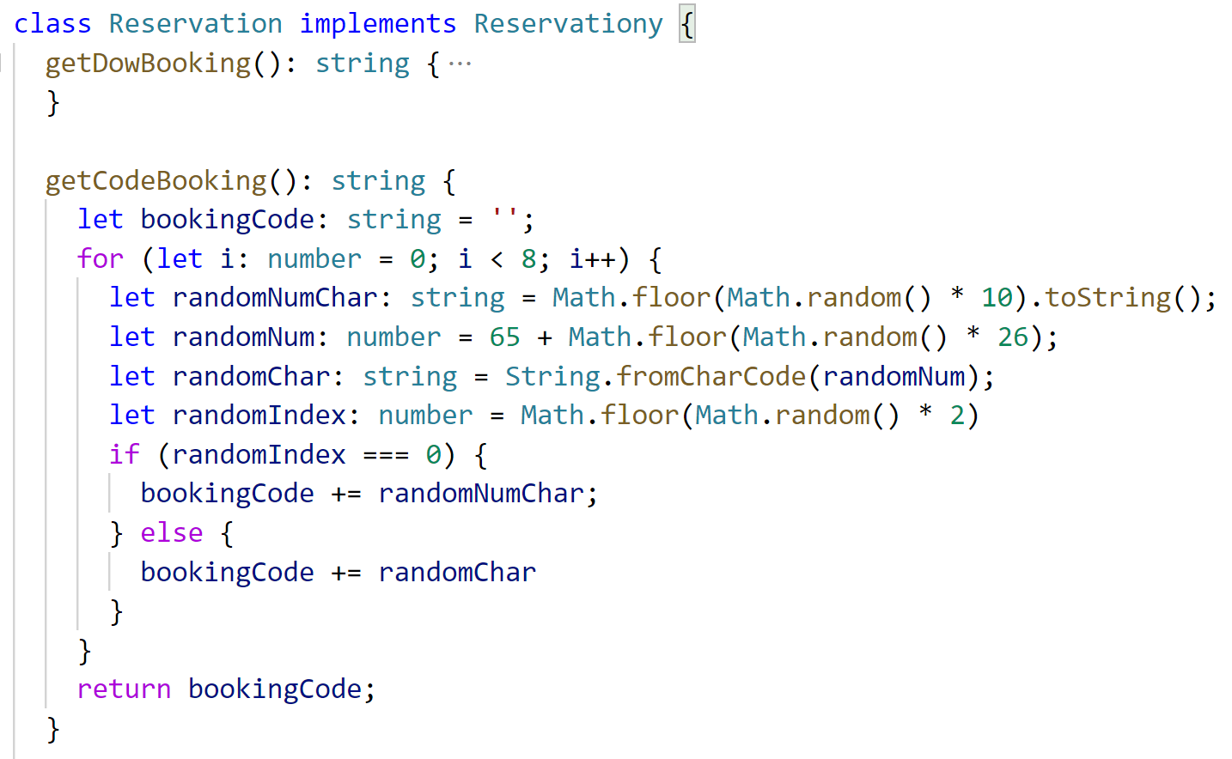
< Reservation exercise >

Slide 5

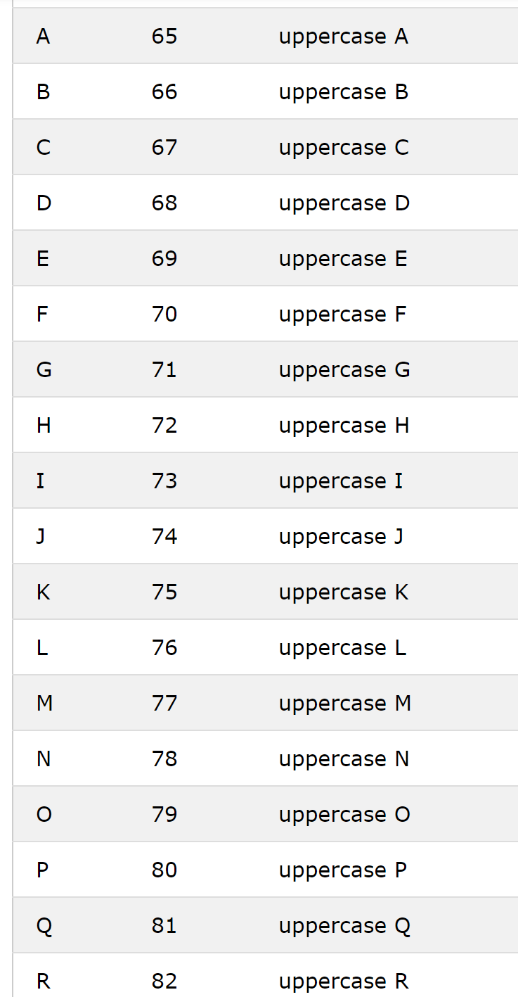
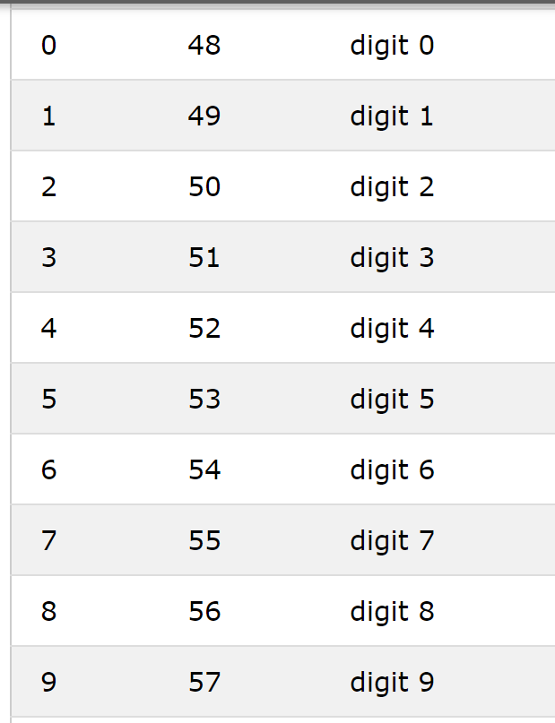
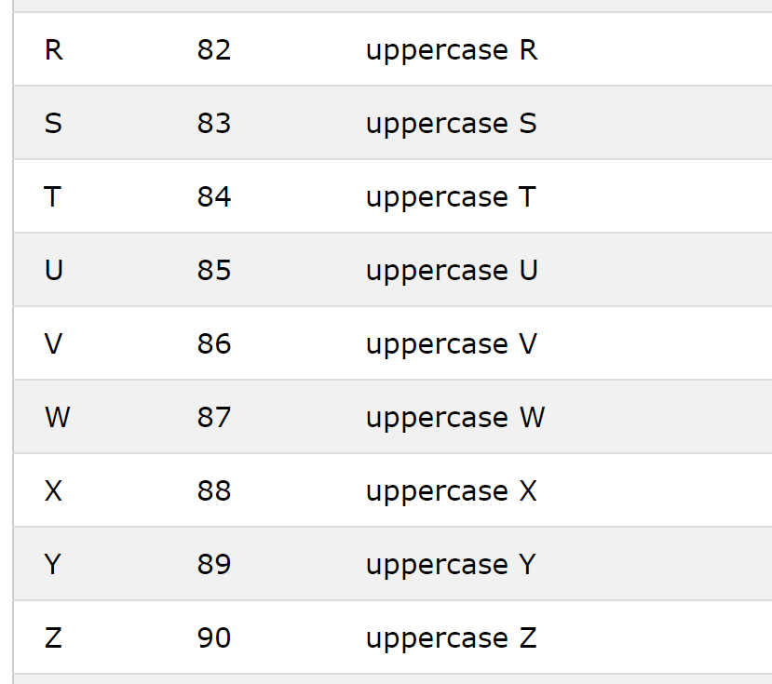
< Character codes || `Charcodes` >

Slide 6
< Reservation exercise >

Slide 7
< Reservation exercise >

Slide 8
< Reservation exercise >
+1 (due to Math.floor())
90 – 65 = 25

Slide 9
< Reservation exercise >

Slide 10
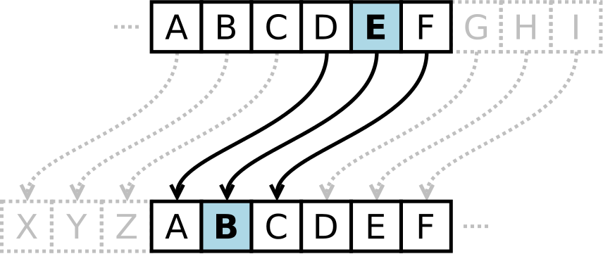
< Caesar cipher >
Plain: ABCDEFGHIJKLMNOPQRSTUVWXYZ
Cipher: XYZABCDEFGHIJKLMNOPQRSTUVW
Plaintext: THE QUICK GREEN FOX JUMPS OVER THE LAZY DOG
Ciphertext: QEB NRFZH DOBBK CLU GRJMP LSBO QEB IXWV ALD

Slide 11
< `Side-effects' Green Fox >

Slide 12


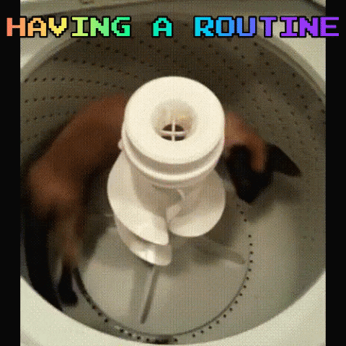
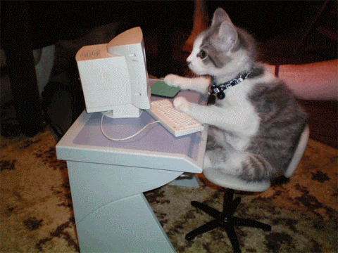
Sleeping better
More walking
Using my brain

Slide 13
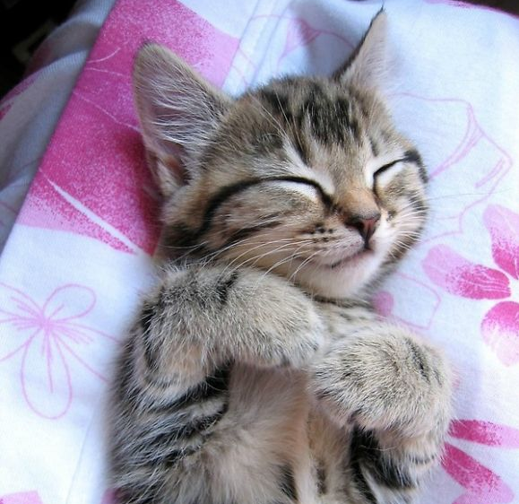
< Summary / Takeaway >

Slide 14
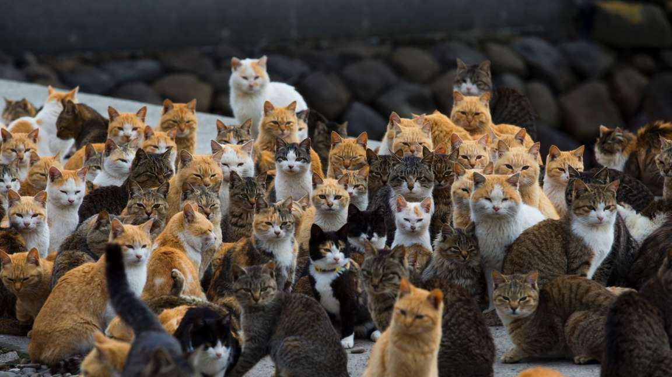
Having a great company

Slide 15
Thank you!
tundecsapo
Tunde Csapo

